Slide 1
IAB-IAD workshop
Group 3:
Organizations

Slide 2
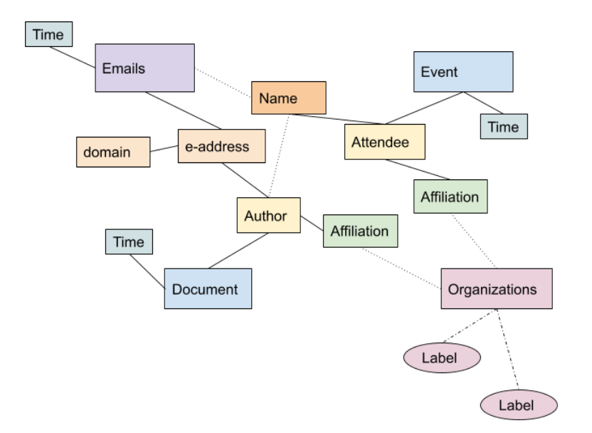

Slide 3
Divide and Conquer
(A) Come up with a systematic stakeholder/organization type taxonomy and labeling method.
Build on 3GPP Organization lists
Add metadata categories
Develop a taxonomy/schema for research data.
Interested:
Elizaveta, Don, Niels, (Nick Doty)
(B) Normalizing, consolidating, matching up organization names or organizational relationships
Lookup of organizations and their relationships/categories from external sources (wikidata, peeringdb, corporate/non-profit records)
Nationality of organization
Interested:
Nick Doty (external sources experimenting)
Justus Baron
Francois Ortolan (limited capacity on Wed)
(C ) Connecting individuals to organizations -- using attendance, documents, email
Automated method for linking email addresses (domains) to organization names via attendance and document records.
Timestamped affiliation and records of changes in affiliation
Indirect affiliation
Handling multiple (noisy) affiliation datasets: IETF datatracker, email domains,
Interested:
S. Benthall, Christoph
[(D) Visualization - Plotting the interactions between mailing list participants by domain and metadata categories. - Christoph]

Slide 4
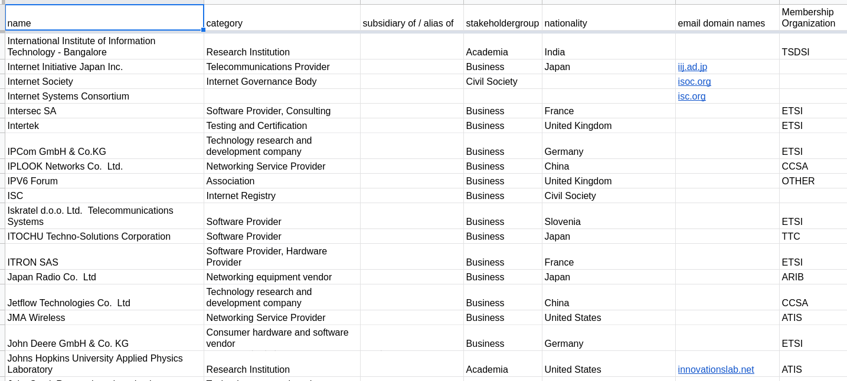
Credit: Elizaveta Yachmeneva, Niels ten Oever

Slide 5
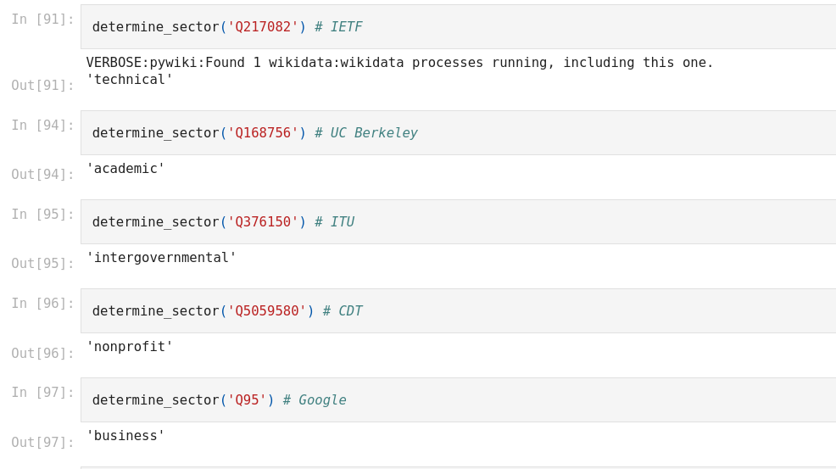
Credit: Nick Doty

Slide 6
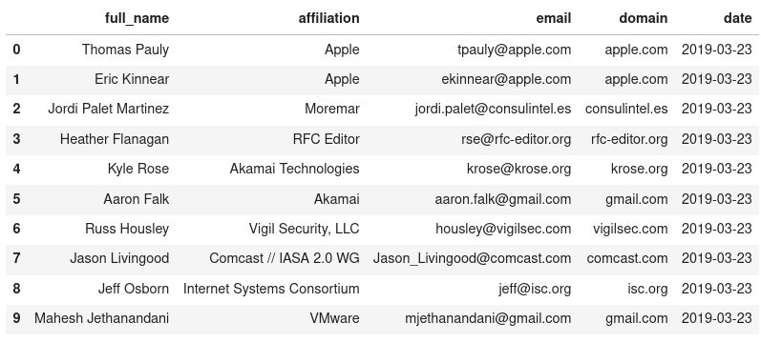
Dated registrant information extracted and transformed from Datatrack. Credit: Seb Benthall

Slide 7
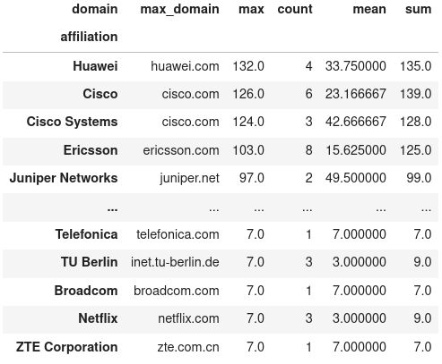
Aggregation and statistically matching affiliations and domains.
Credit: Seb Benthall

Slide 8
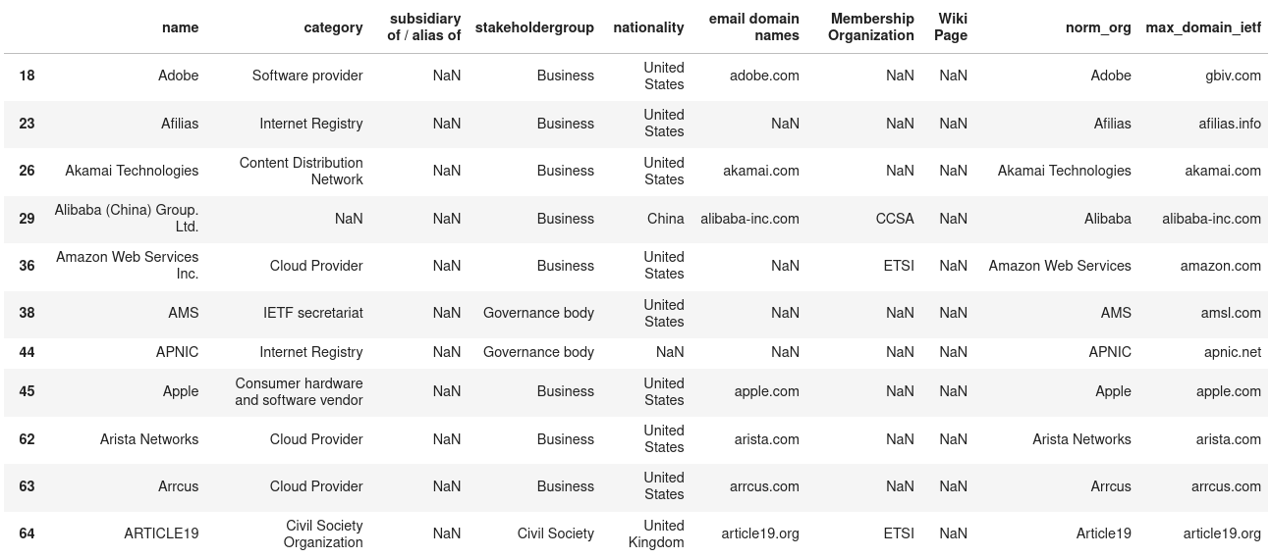
Combining results from Group A with data from Group C via entity resolution. However, still work to be done on cleaning e.g. personal email domains.
Credit: Seb Benthall

Slide 9
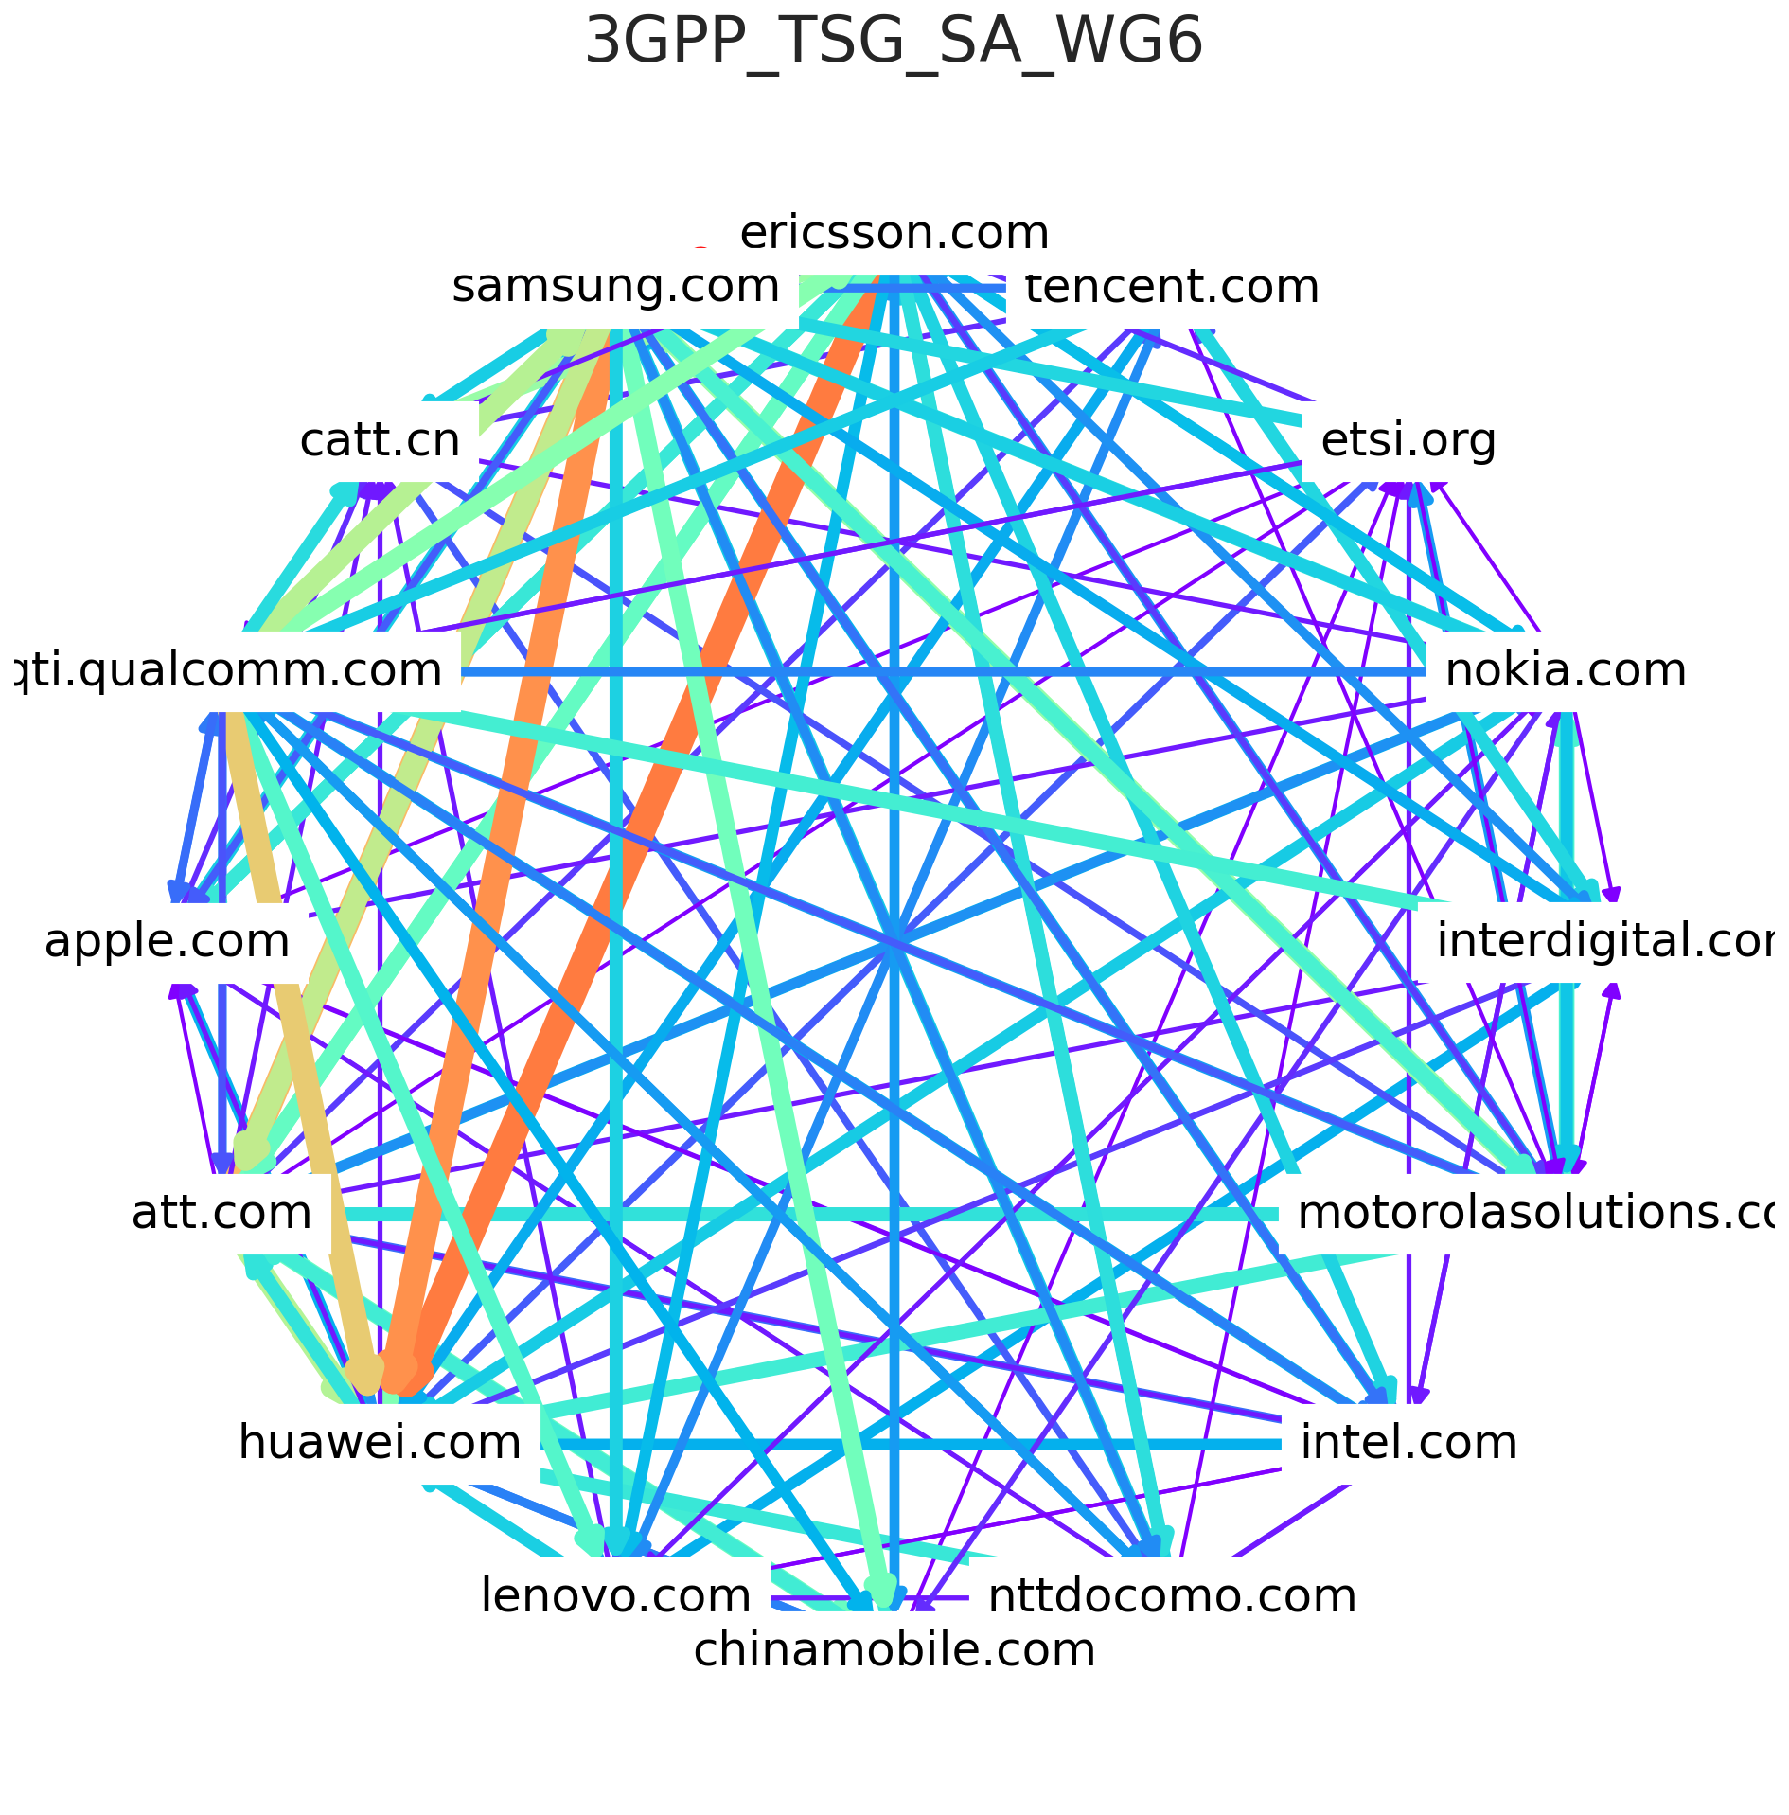
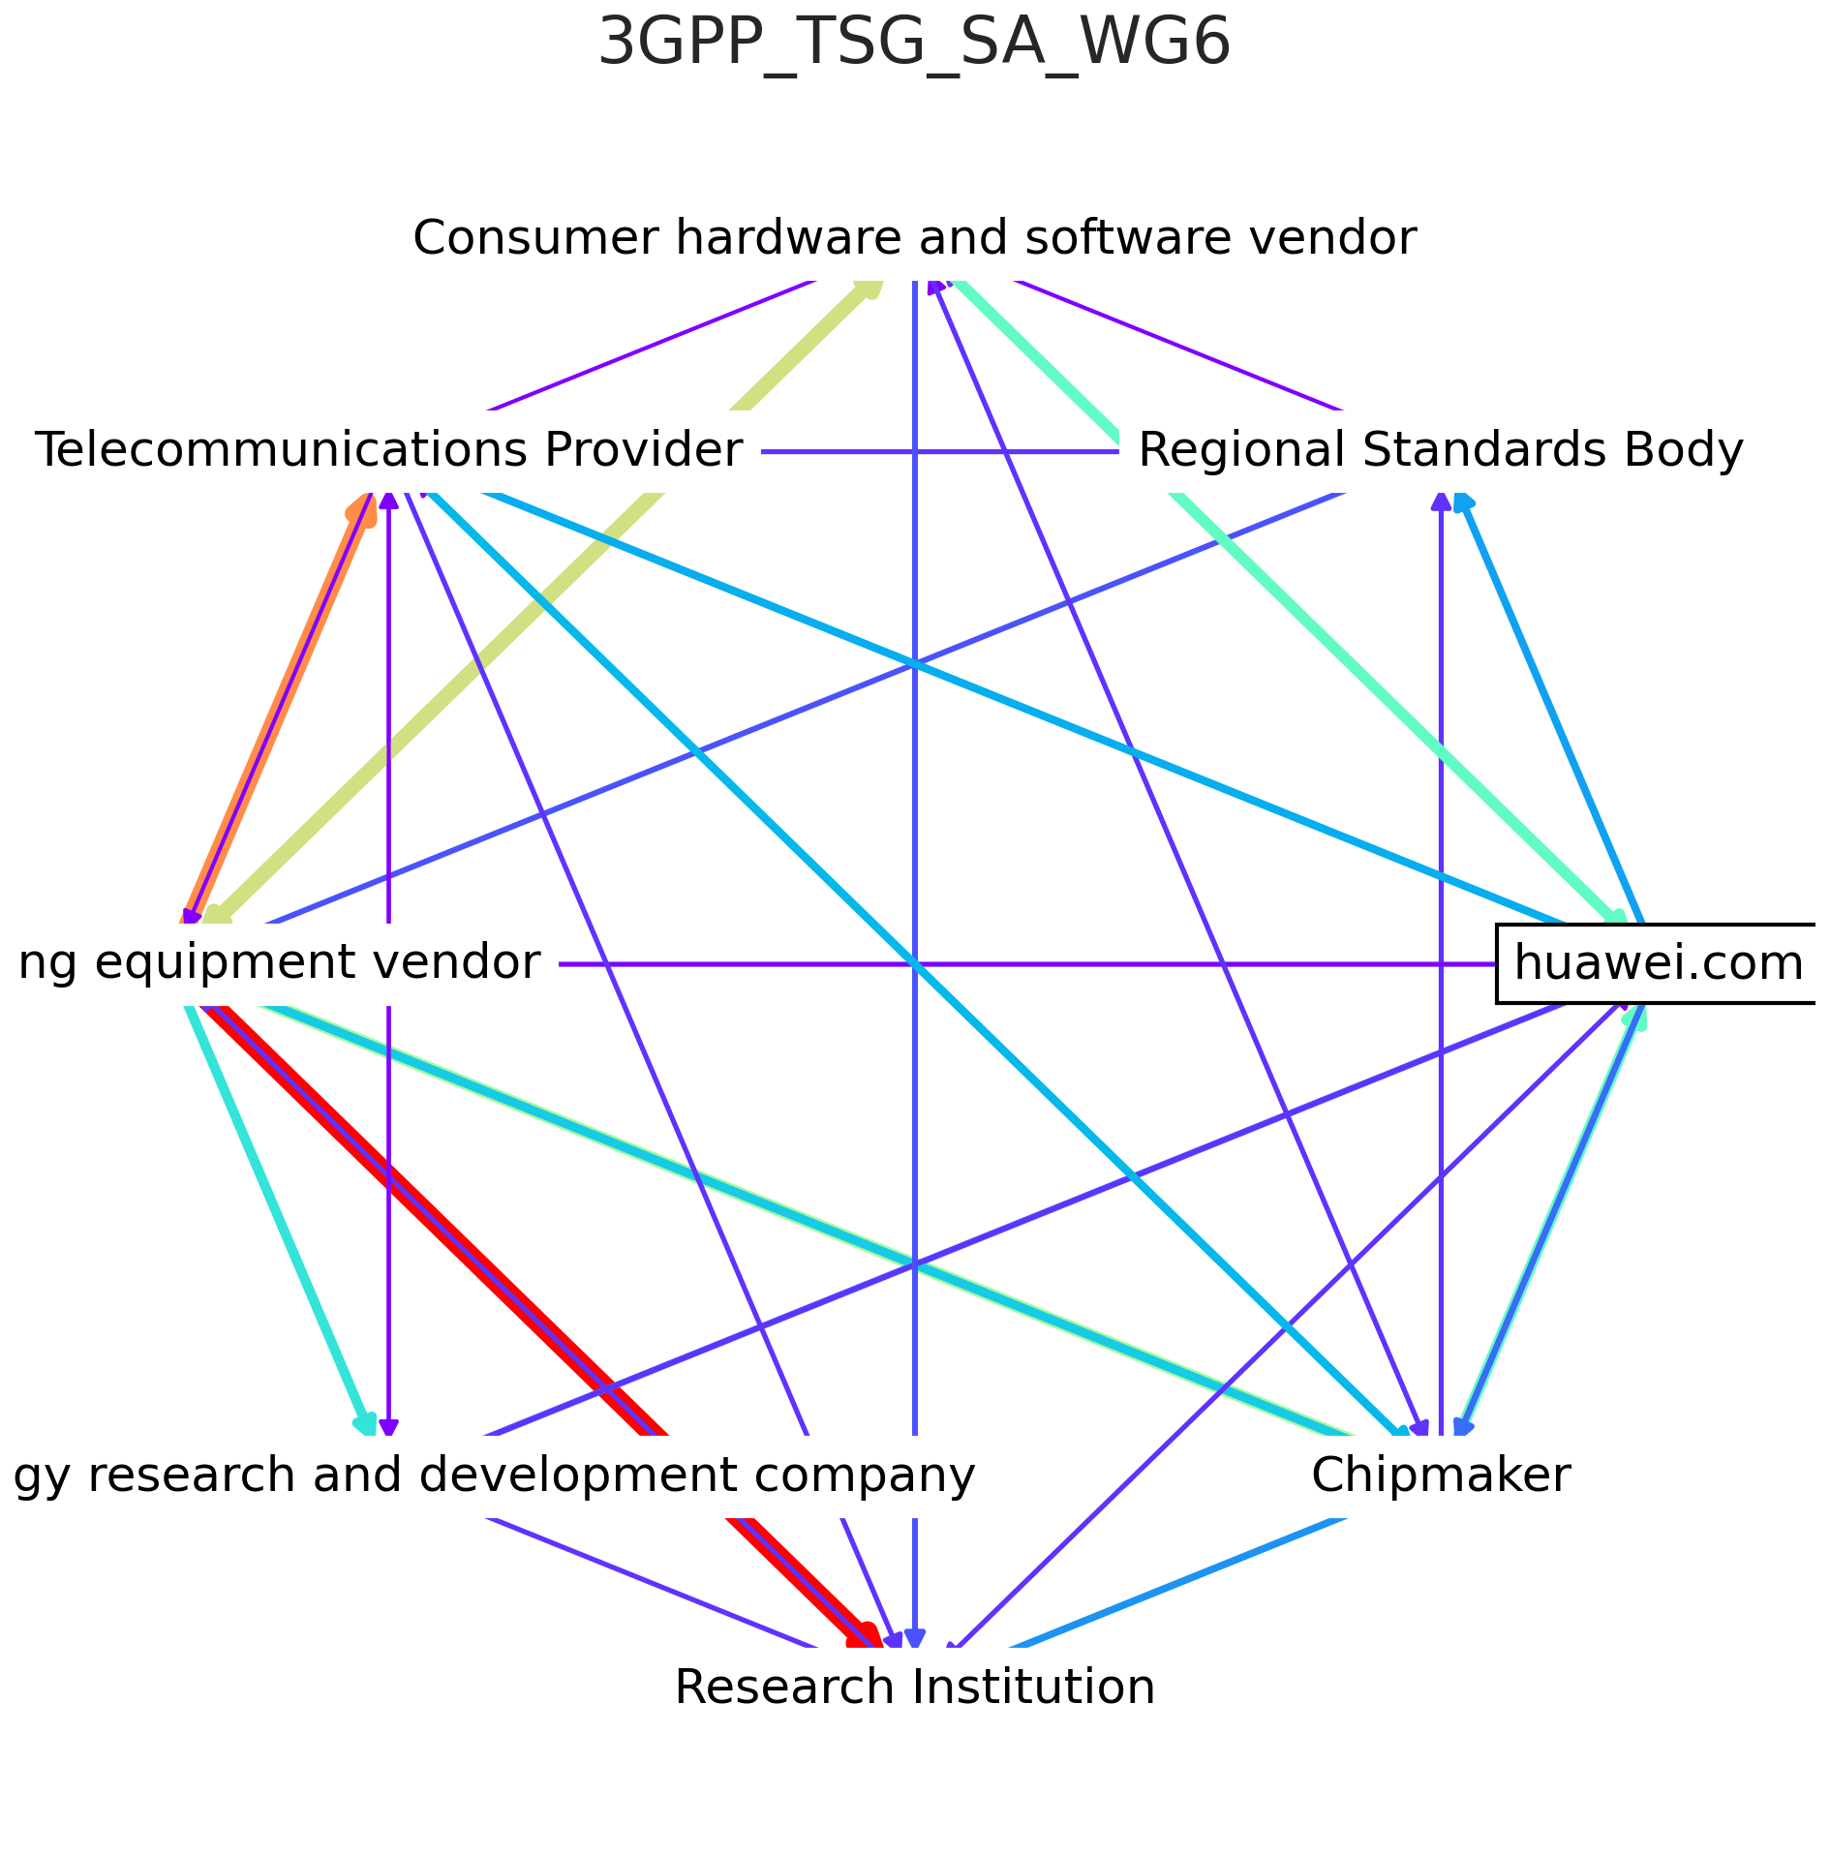
Credit: Christoph Becker

Slide 10

Insights and future work
This work proves that value of combining data derived from multiple SDOs, external sources, and “gold standard “ hand-curated data.
These data and scripts have all been added to the BigBang open source software project
In the future, we look forward to systematically populating our database to support research and administrative insight into organizational involvement in SDOs.

